Slide 1
Plan and Schedule Comments Test Plans
Approaches
How to Construct

Slide 2
Plan and Schedule Comments
Overall Very Good
Necessary Tasks Were Included
Duration of Tasks and Effort Appears Reasonable
Potential Issues
Testing Scheduled Late in Semester Leaves Minimal Time to Address Problems => Do as Much low-level testing as possible in advance
Some Requirements Will be Challenging to Verify
Overly Broad
Multiple Parts
Not as Quantitatively Specified as Desirable
Several Projects Did Not Follow Directions for Report?!

Slide 3
Testing and Test Plans Need and Uses
Successful Execution of the Test Cases in the Test Plan is the Basis for Showing That the Project Has Met the Customer’s Requirements
The Test Cases are Also Useful for Debugging During the Design Process
Identify Requirements Not Addressed
Identify Problems Early so They Can be Addressed
Identify Test Issues (e.g. Needed Equipment) That May Have Been Overlooked

Slide 4
The Test Process
Typically an Independent Test Team Will Conduct Final Testing to Help Assure Objectivity.
The Independent Test Team Will Follow the Test Plan Literally => All Information Must Be Present
Deliver to Customer
Requirements & Constraints
Dry Run of
Test Plan by Project Team
Execution of Test Plan by Independent Test Team
Execution of
Test Plan for Customer
Y
Test Plan
Y
Y
OK
Pass
Pass
N
N
N
Detailed Design
Revise Design
Modify Requirements & Constraints
Modify Test Plan

Slide 5
Test Plans vs. Test Procedures
The Test Plan
High level document that describes overall test strategy
Test equipment required
Location(s) of testing
Overall test flow (preliminary, final, etc)
Applicable requirements documents, software, etc.
The Test Procedure
Detailed document that lists step-by-step instructions for verifying each requirement
The test procedure is the document that must be “passed” by the customer for the project to be successful
ECE 458
We will essentially combine the above documents and call the result our TEST PLAN. This is appropriate based on projects scope

Slide 6
Format for Test Plans
Topic and Notes | Typical Number of Pages
Title Page | 1
Background, Overview, and Brief Description of Project and Objectives- Reuse from Earlier | 1-2 pages
Engineering Requirements (from your PDR Report) (Update as required for new rqmts.) Requirement numbers and ID are required | TBD pages as needed
VCRM (you should have the basis for this from PDR) | 1 page
Test Cases Data or Measurements taken (to be taken) as part of test case | 1 page per requirement for test case– As many pages as needed to address requirements
Summary Matrix and Comments | 1 page
Updated Plan and Schedule | 1-2 pages

Slide 7
Engineering Requirements IDs and Test Numbers
Both Engineering Requirements and Test Numbers are Key for Tracking Testing and Results
Engineering Requirements ID’s Should be the Left Hand Column of Your Engineering Requirements Table
Test Numbers Associate Requirements With Tests and Test Results
Note That One Test Case May Test Multiple Requirements
Multiple Test Cases May be Required to Test Complex of Multi-Part Requirements

Slide 8
Engineering Requirements (From PDR and Plan & Schedule)
Customer Rqmt No. | Engr. Rqmt ID | Engineering Requirement | Comments and Where Met in Design | Verification Method
1 | 1.0 | Temperatures must be measured to 1 degree C |  | Test
2 | 2.0 | Temperatures must be measured every 50 feet |  | Demonstration
3 | 3.0 | Tethered Balloon |  | Inspection
Engr. Rqmt ID | Engineering Requirement | Comments and Where Met in Design | Verification Method
1 | System must measure temperature between 0° F and 100° F with an accuracy of 1° F | Met with Digikey sensor. Raspberry Pi to sample raw data, and ground processing to convert data from binary to temperature Preliminary bench testing of sensor, data acquisition, and software conversion from binary to temperature complete | Test
2 | System must position sensor at 50 ft intervals with less than 1 minute between samples | Met with XYZ winch and controller with USB interface that provides control and readout of number of turns of winch drum Software will control winch and convert number of turns to altitude reading Waiting for winch controller to arrive | Test
3 | System must operate in field for 7 days 24 hrs/day | Power requirements for Computer, Raspberry Pi, LED FAA beacon, and Winch controller estimated- 5000 W Hrs @ 50 degrees F; one set of readings per hour | Analysis

Slide 9
VCRM
The VCRM- Verification Cross- Reference Matrix
Engineering Requirement ID | Verification Method Inspection Analysis Demonstration Test Comments
1 |  |  |  | x
1.1 | x
--
--
N
The VCRM summarizes approach to verification of each requirement
Typically the Comments Column is used to describe any special/ atypical items associated with test. (e.g. location, access to special test equipment)

Slide 10
VCRM Definitions
Inspection
Examination of the product or system using one or more of the senses.
Analysis
Verification of a product or system using models, calculations or simulations. Analysis is typically used either where it would not be practical to conduct a test or demonstration or when a test or demonstration would result in damage or destruction of the system
Demonstration
The operation of the product or system as it is intended to be used to verify that the results are as planned or expected.
Test
The verification of a product or system using a controlled and predefined series of inputs, data, or stimuli to ensure that the product or system will produce a very specific and predefined output as specified by the requirements.

Slide 11
Test Case Format- Portrait
Saved on m: drive as
ECE 458 Test Case Template_Portrait.docx

Slide 12
Test Case Format- Landscape
Saved on m: drive as ECE 458 Test Case Template_Landscape.docx

Slide 13
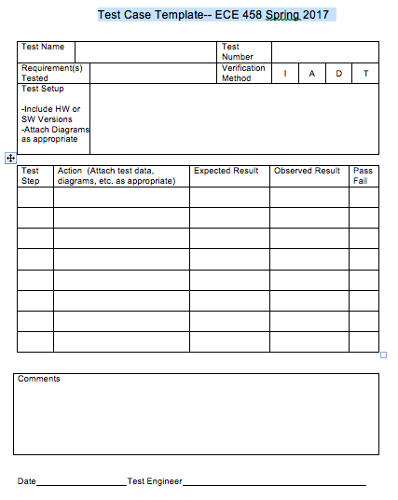
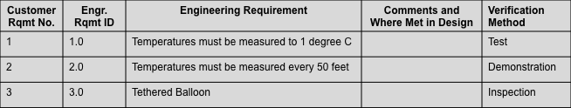
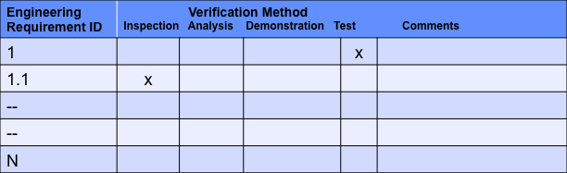
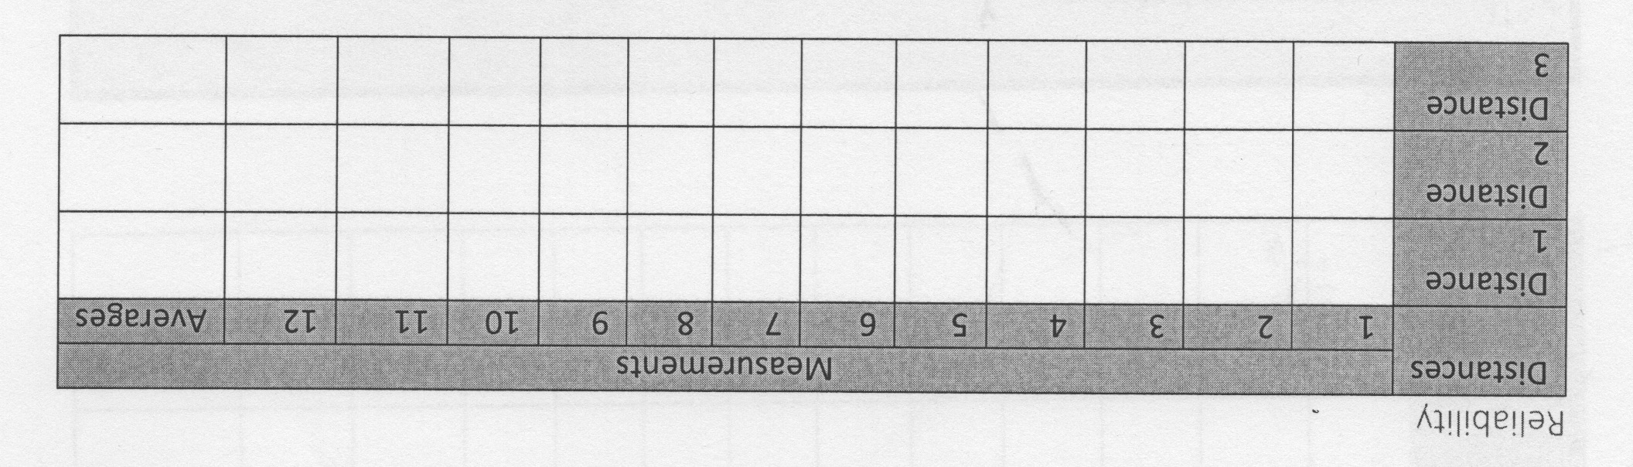
Test Case Documentation
Engineering Requirements
Completed in Test Plan
Completed in Test Report
VCRM
Example that shows data that would be collected to verify that requirement was met

Slide 14
Test Summary
Engineering Requirement ID’s and Test Numbers, Both of Which are Taken from Test Cases Will be Completed in the Test Plan
The “Pass/Fail” and “Comments” Sections of the Test Summary Will Be Blank in the Test Plan. They Will be Completed in the Test Report.

Slide 15
Plan and Schedule Update
Update Plan and Schedule
Tasks completed (include actual hours)
Tasks rescheduled or delayed
Other changes to Plan and Schedule
Key is to Simply Update Your Plan and Schedule
Extensive explanations not required
Differences between actual vs. planned hours will NOT affect grade. Comparing them is a learning experience.

Slide 16
Keys to a Successful Test Plan
The order of test case execution is Important
See following slides
Requirements must be capable of being tested
Requirements must address all aspects of the project
If they do not then the test plan will be unable to verify that all requirements are satisfied.
Although not mandatory it is a good practice to have one test case per requirement.
One test case may verify more than one requirement but it must be possible to determine that each requirement is satisfied.

Slide 17
Test Methods
Inspection
Examination of the product or system using one or more of the senses.
Analysis
Verification of a product or system using models, calculations or simulations. Analysis is typically used either where it would not be practical to conduct a test or demonstration or when a test or demonstration would result in damage or destruction of the system
Demonstration
The operation of the product or system as it is intended to be used to verify that the results are as planned or expected.
Test
The verification of a product or system using a controlled and predefined series of inputs, data, or stimuli to ensure that the product or system will produce a very specific and predefined output as specified by the requirements.

Slide 18
Test Strategies
Design Overall Test Flow to Avoid Repeating Test Steps to Maximum Extent Practical
Bottoms- Up Testing is the Most Common Approach to Achieve Efficient Testing => Perform Lowest Level Tests First
Document Input Conditions, Data, and Software Used for Lower Level Testing Because These Need to be Known for Higher Level Tests (same or different? Integration testing)
Within a Single Test Case, Design the Test Steps to Proceed from Lowest Level to Highest Level
Motivation is to Minimize Uncertainty About What Works (or Doesn’t Work) at Each Stage of Testing
Note- The “bottoms up” approach is similar to what we
do in everyday life when solving problems

Slide 19
Requirement --> Test Case --> Project Mapping Example 1
System
Subsystem 1
Subsystem 2
Subsystem 3
Rqmt A
Rqmt B
Rqmt C
Test Case 1

Slide 20
Optimum Test Case Execution Order Example 1
Bottoms Up Testing In Both Cases
Test Case 1
Test Case 2
Test Case 2
Test Case 1
OR
Test Case 3
Test Case 3

Slide 21
Requirement --> Test Case --> Project Mapping Example 2
Requirement A is Associated With Multiple Parts of the System
Test Flow in Test Case is “Bottoms-up” (Subsystems Before System)
Test step Order
Of execution
System
Subsystem 1
Subsystem 2
Rqmt A
Test Case 1

Slide 22
Optimum Test Case Execution Order Example 2
Subsystem 2
Subsystem 1
Subsystem 1
Subsystem 2
Structure the Test Case to test the lower level subsystems first followed by the system level test
OR
System
System

Slide 23
Requirement --> Test Case --> Project Mapping Example 3
Rqmt A
Rqmt B
System A
Subsystem 1
System B
Subsystem 2
Subsystem 3
Rqmt C

Slide 24
Optimum Test Case Execution Order Example 3
Test Case 1
Test Case 1
In this situation it may be desirable to write 3 Test Cases.
Note that this may result in more than one test case for a requirement, depending on how the requirement(s) are written.
The above could be avoided by re-writing a requirement to address Subsystem 3 separately
Test Case 2
Test Case 3
OR
Test Case 3
Test Case 2

Slide 25
Requirement --> Test Case --> Project Mapping Example 4
Rqmt A
Rqmt B
System A
Subsystem 1
System B
Subsystem 2
Subsystem 3
Test Case 1

Slide 26
Optimum Test Case Execution Order Example 4
Test Case 1
This situation is undesirable because it duplicates a test.
This raises the possibility that the test conditions could be different and produce different results which would then have to be resolved.
Test Case 2

Slide 27
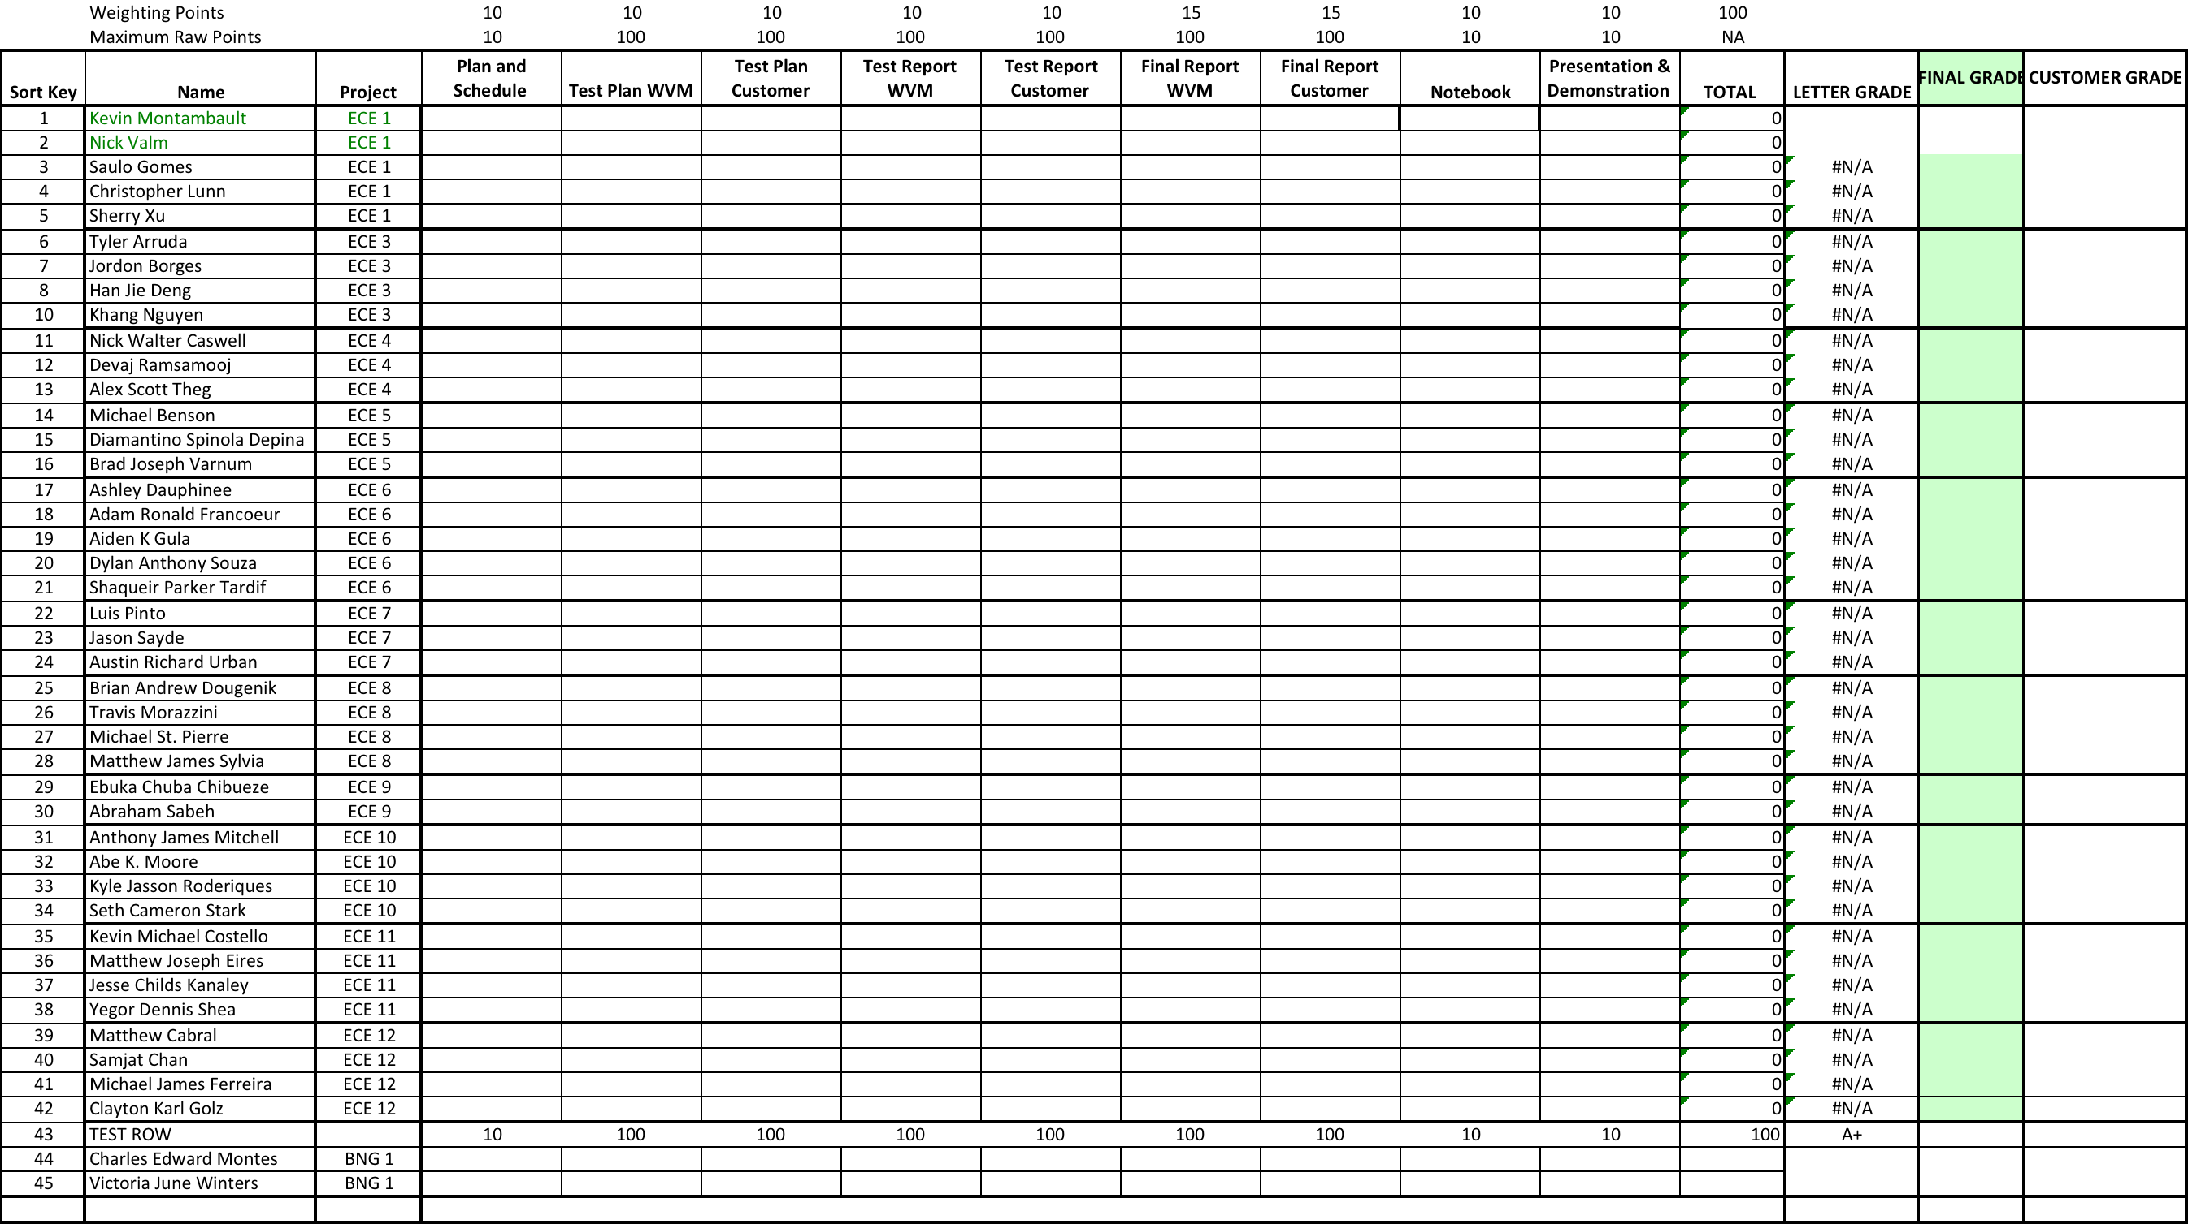
Example- Sr Design Grade Sheet
=D4+0.1*(E4+F4+G4+H4)+0.15*(J4+I4)+L4+K4

Slide 28
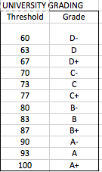
Example- Sr Design Grade Sheet

Slide 29
Test Case for Grading Spreadsheet

Slide 30
Test Flow Overview (For Reference)
Functional
Requirements
System V&V
Test Plans and Procedures
Design Level
Requirements
Integration & Subsystem V&V
In general, testing proceeds from lower levels to higher ones. If issues are found at higher levels of testing the knowledge gained from lower level tests is a great help in addressing them.
Detailed Design and Implementation
Early consideration of how to test can help define requirements in a way that makes them easier to verify
Verifying lower level requirements during design and implementation helps ensure that higher level ones will be met at system V&V

